Slide 1

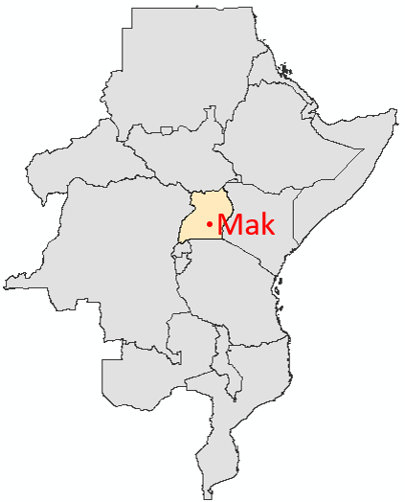


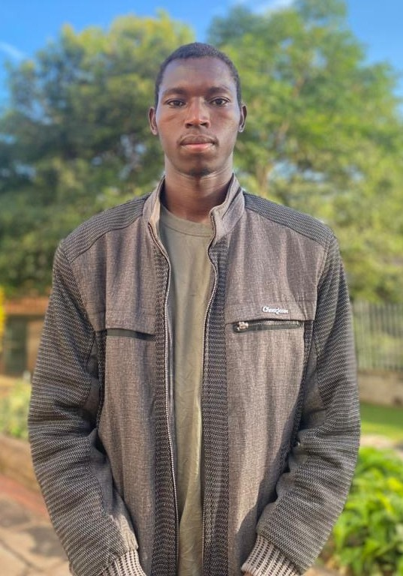
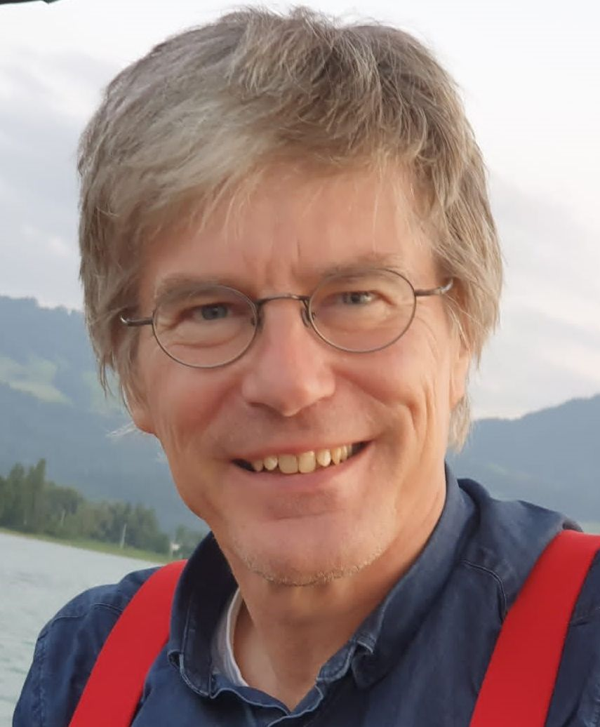
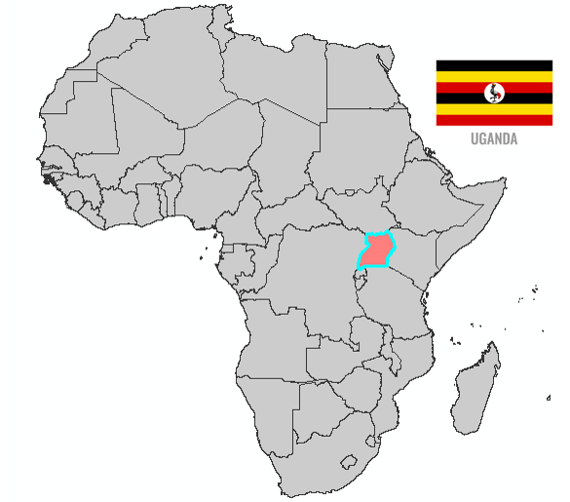




Lokong Peter
University: Makerere University
Study program: Agricultural Engineering
Year of study: 4th year
City: Kampala, Uganda
Motto for life: Engineer today, sustain tomorrow, empower communities for generations.
Hobbies: Football, swimming, music, reading novels
Your expectations from the summer school:
I expect to gain practical sustainability knowledge, build international networks, and apply innovative engineering solutions.
Location where I study,
and where I live
Karlsruhe
31 August to 11 September 2026

